Slide 1

Eco Schools

Slide 2

Working together with all staff and pupils to achieve the Green Flag award for our school.

Slide 3
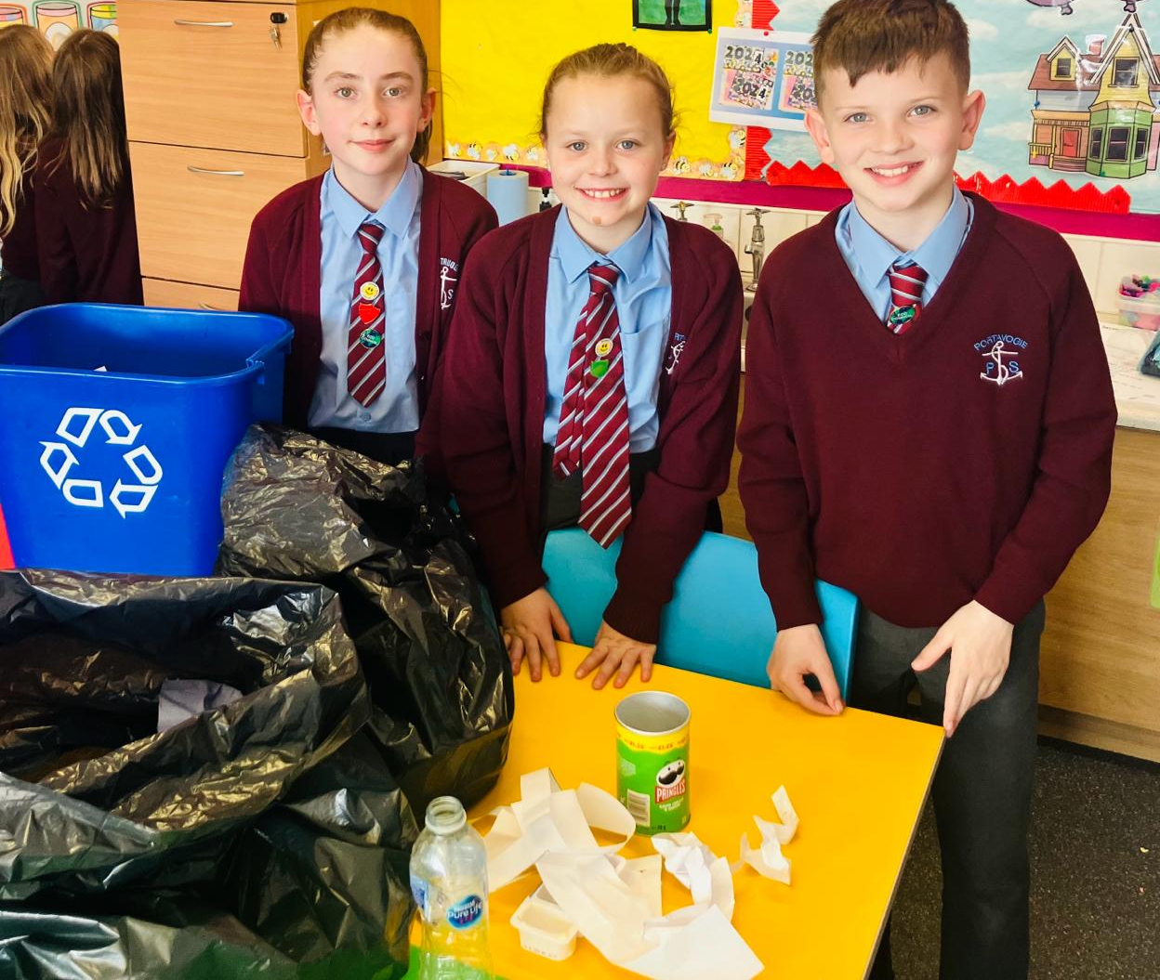

Target - Recycling

Slide 4
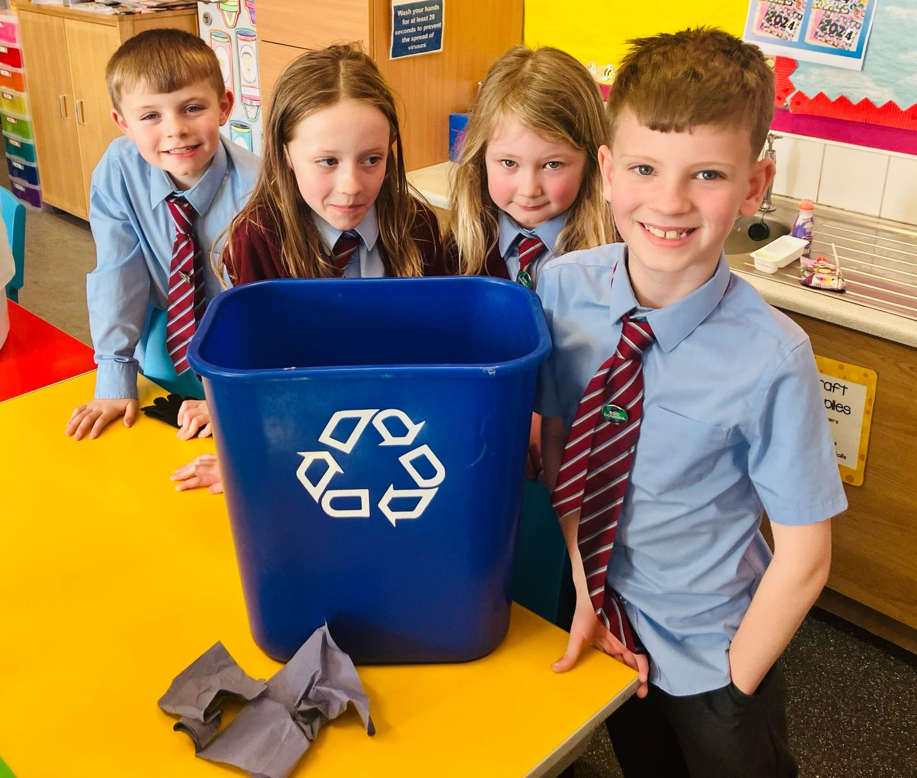
What we have found out…
Most areas in school were recycling quite well but there are some items that keep appearing in the wrong bins. The main areas in school that need work are:
Hall (lunchtime)
Staffroom
Classroom (P5 and P7)

Slide 5

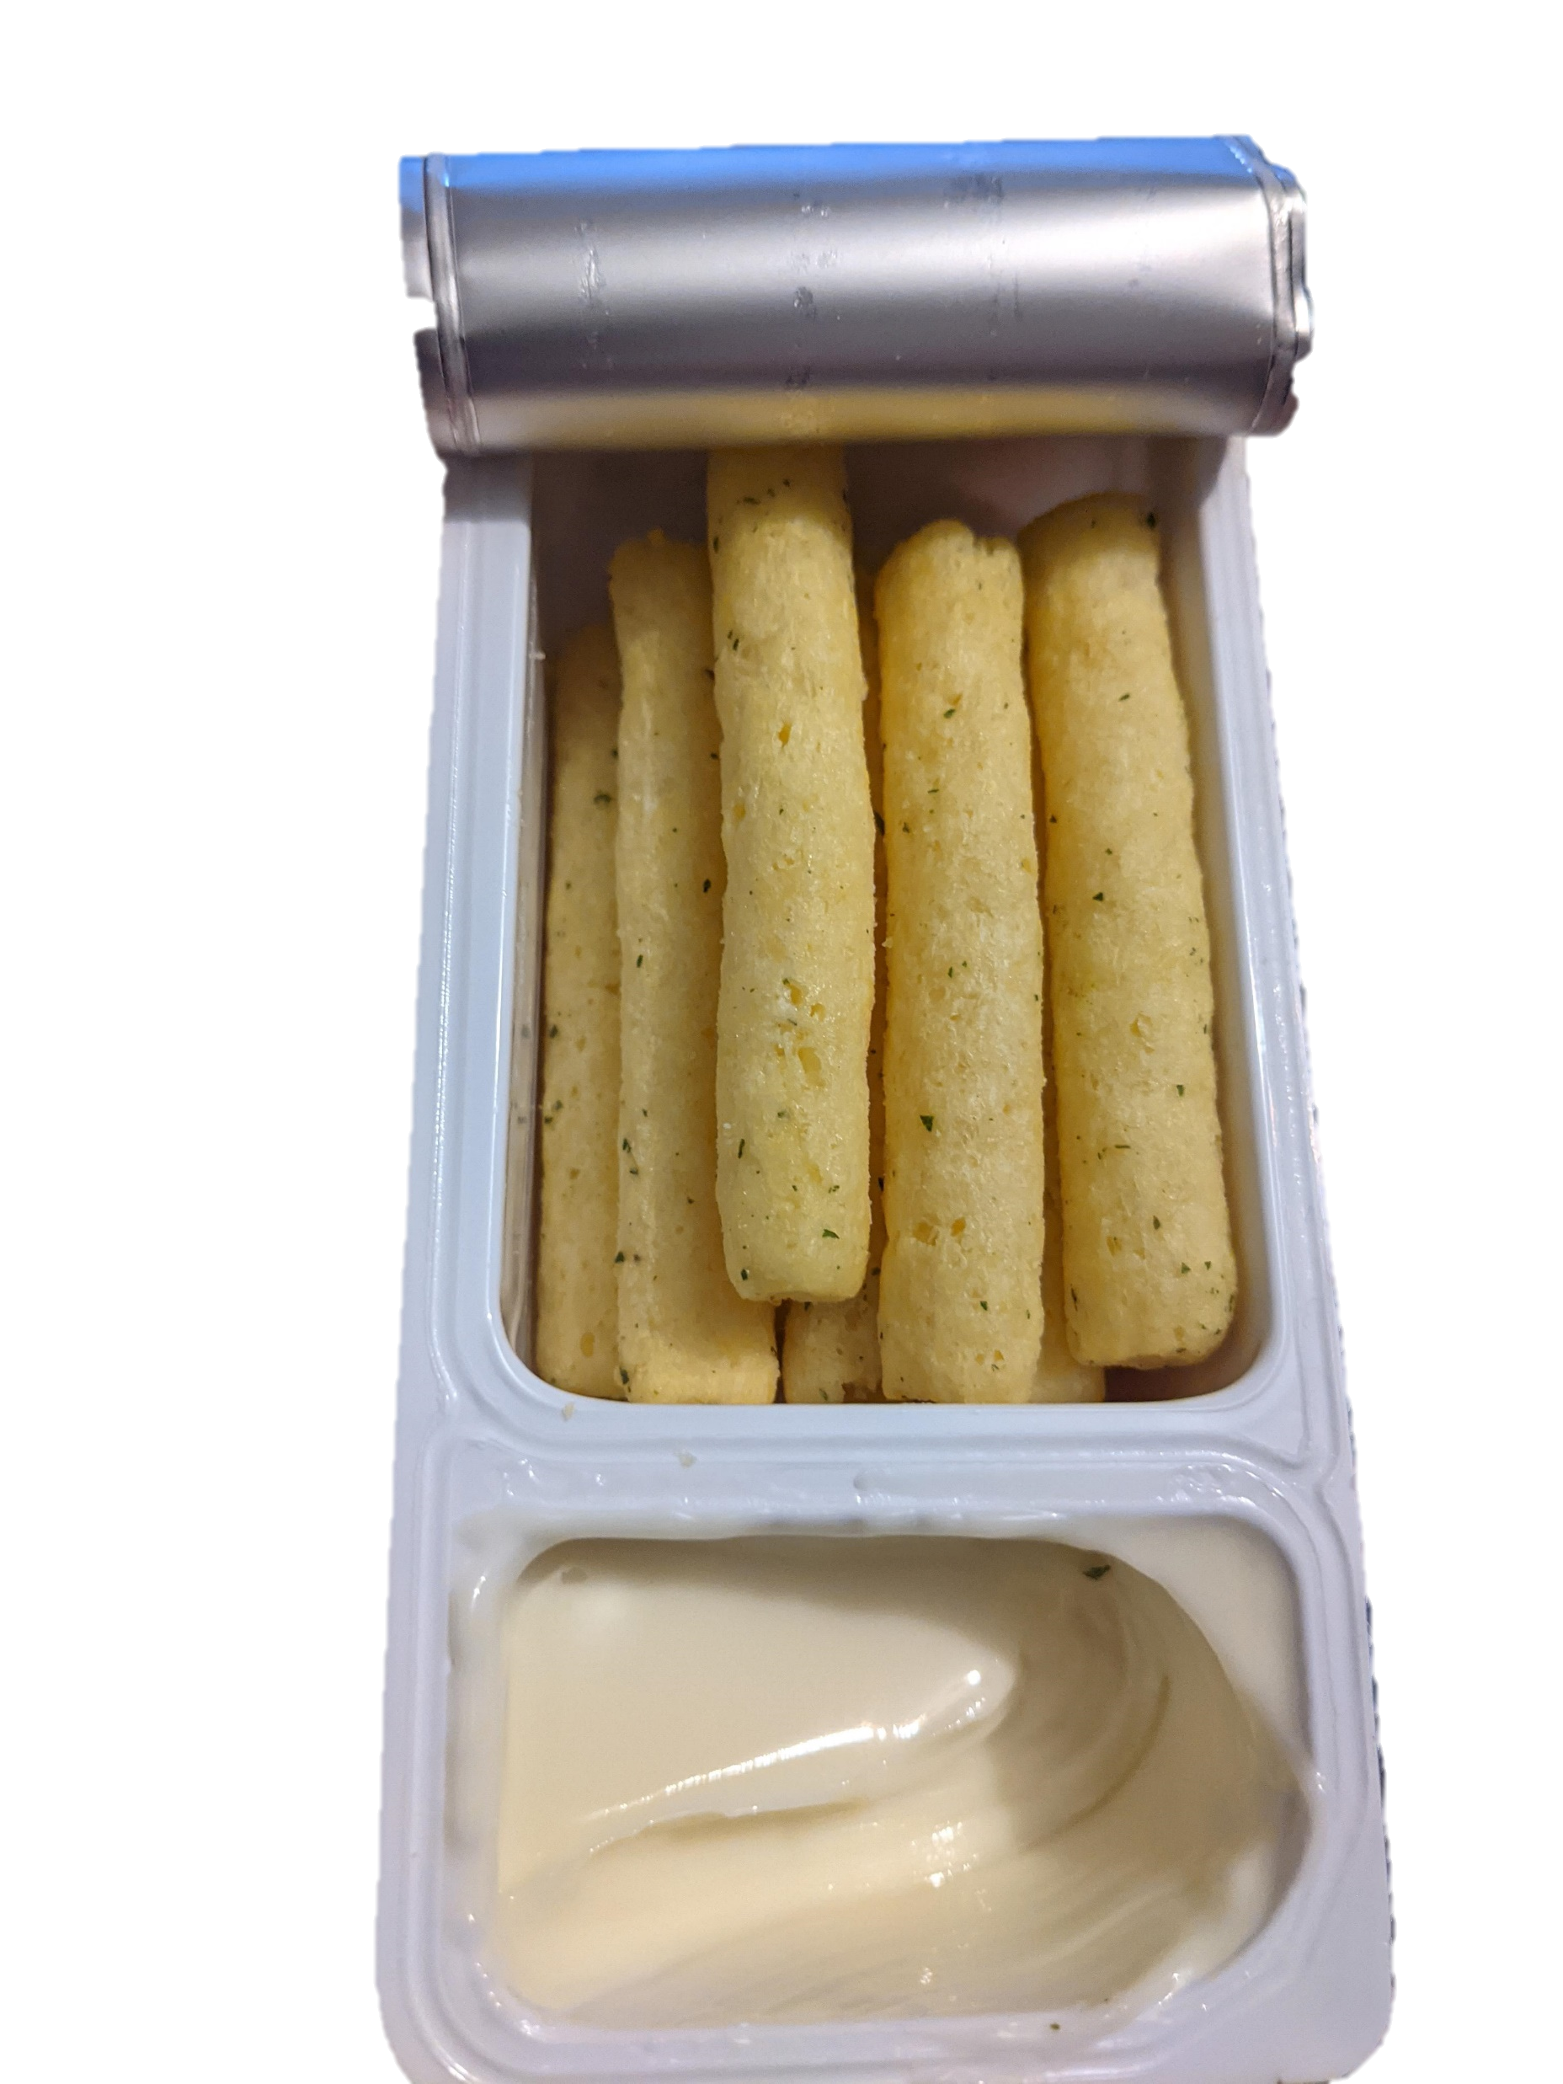
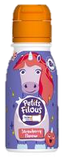
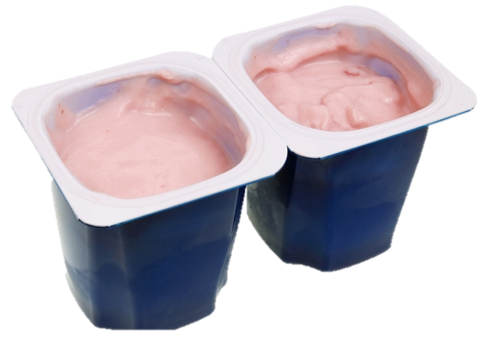
What can be recycled?
Hard plastic
Dairylea Dunkers
Drinkable Yoghurts
Plastic Bottles
Yoghurt pots
ALL items MUST be washed before putting in the bin.

Slide 6
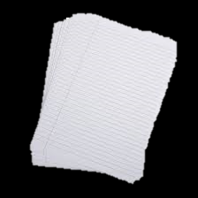

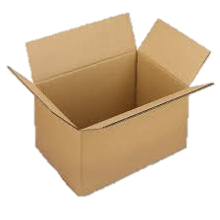
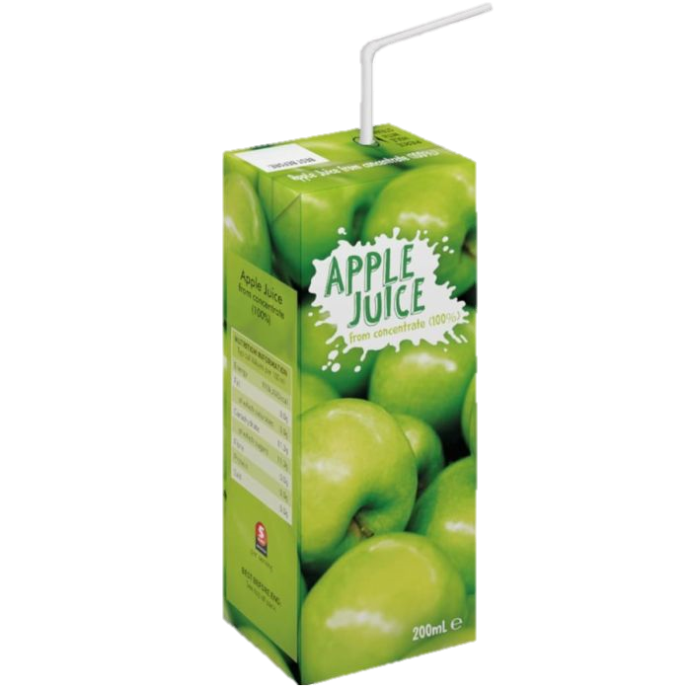
What can be recycled?
Most types of paper…
paper
Card
Cardboard
Juice Cartons and paper straws

Slide 7
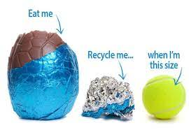
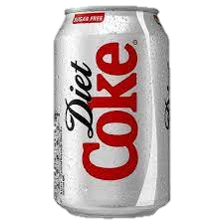
What can be recycled?
Other items…
Tin cans
MUST be washed.
Tin Foil (the size of a tennis ball)

Slide 8
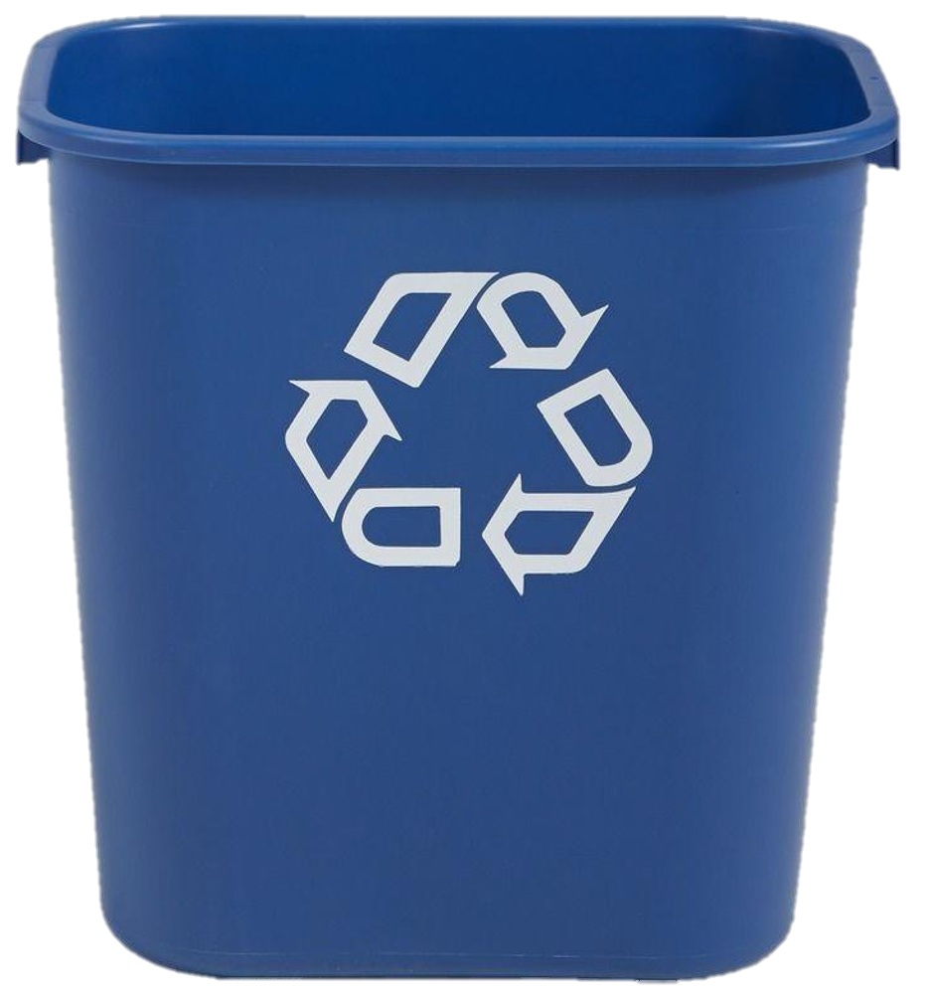
All of these items MUST be put in the blue bins found in all rooms in school.

Slide 9
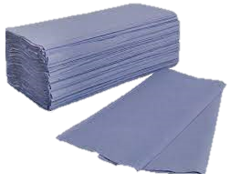
What can NOT be recycled?
Paper towels

Slide 10

What can NOT be recycled?
Tissue Paper

Slide 11
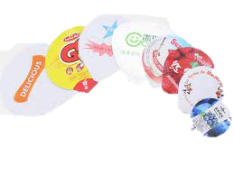
What can NOT be recycled?
Lids from items like yoghurt pots and Dairylea Dunkers

Slide 12
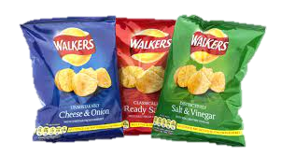
What can NOT be recycled?
Crisp packets

Slide 13
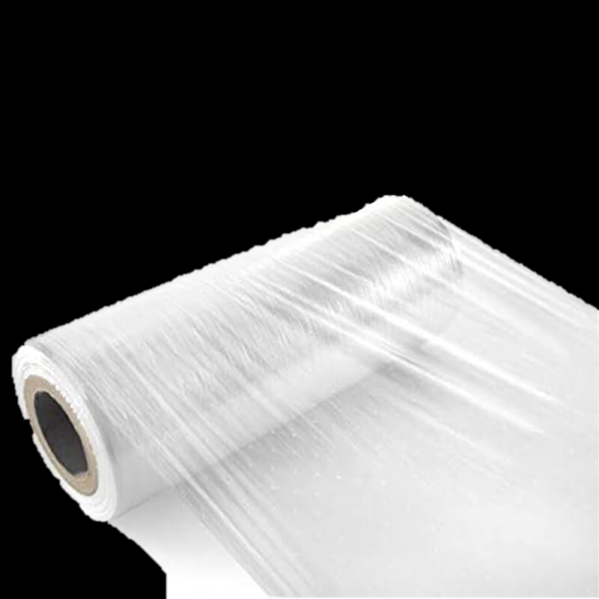
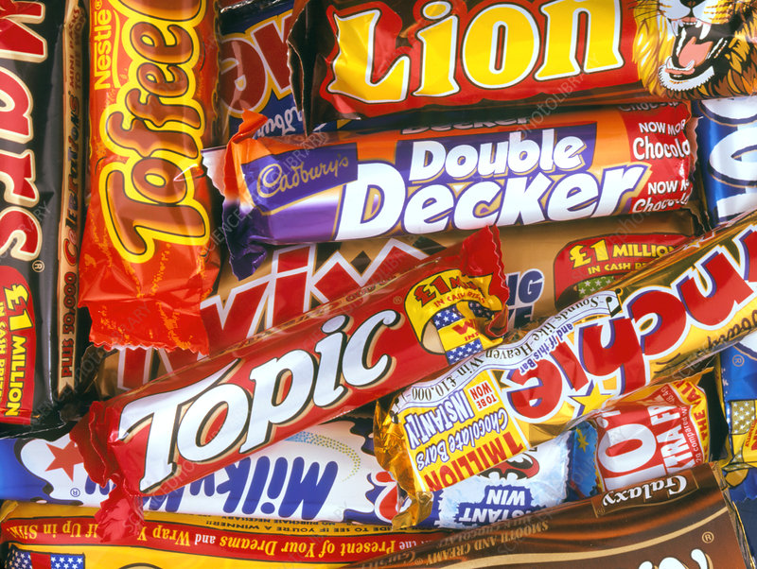
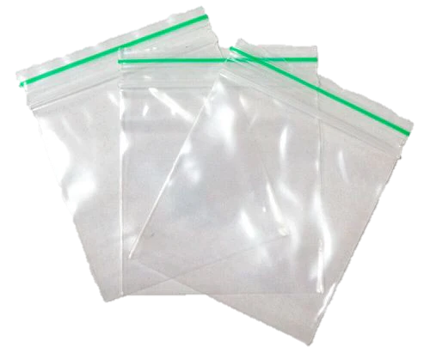
What can NOT be recycled?
Soft plastic wrapping

Slide 14
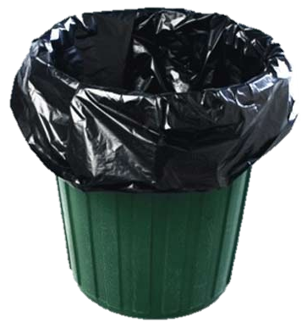
All of these items MUST be put in the waste bins (with a bin bag) found in all rooms in school.

Slide 15
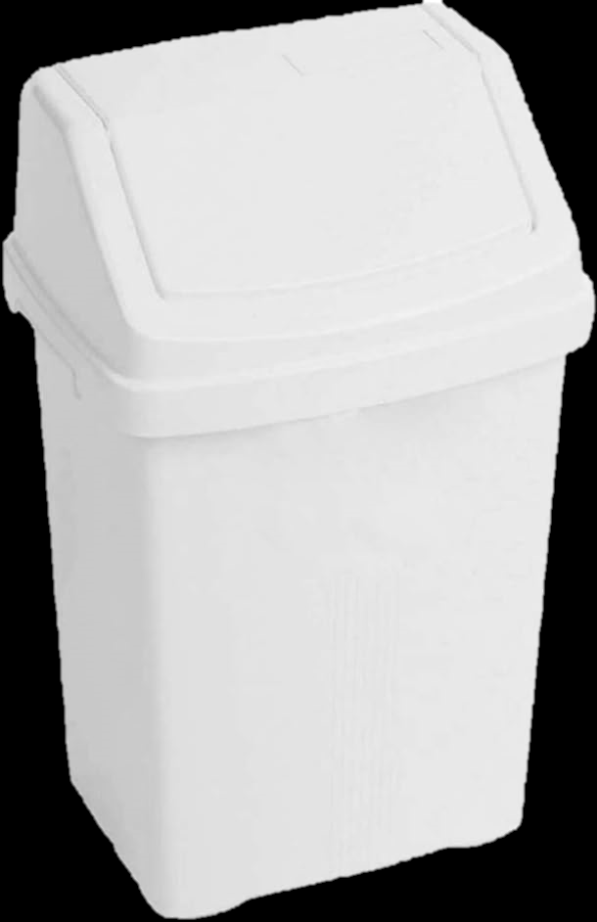
Where do food items go?
All food items MUST be put in the food bins found in all rooms in school.

Slide 16
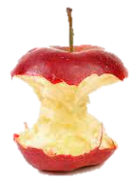
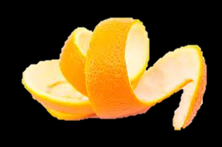
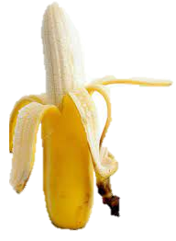
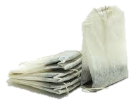
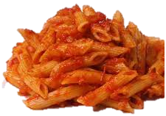
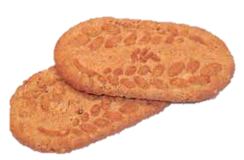
Which food items does this include?
All foods but NO packaging!

Slide 17
Who is responsible?
All staff and all pupils to help to achieve the Green Flag award for our school.

